Slide 1
Open a restaurant in Tennessee

Slide 2
Introduction
As the global pandemic is cooling off, people are ready to go out to see the world and tourism is looking for have activities back. As a resident, I am looking forward to see the revival of tourism in Tennessee.
Tourism brings in visitors, which bring in revenues to restaurants, hotels, and other consumptions. It also produces little pollutions compared to other industries like manufacturing. Therefore, promoting tourism is always a great way to generate revenue for any state. In particular when people are eager to travel now, it's time to look at how to get a slice of that cake as small business owners who are interested in opening a restaurant!

Slide 3
Problem
All the benefits of tourism bring economic growth to the state and its people.
The objective of this project is to analyze places to tour in TN and try to recommend the best location where they can open a restaurant or lodging to make the best use of the opportunity.

Slide 4

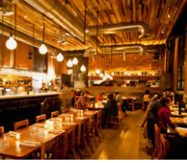
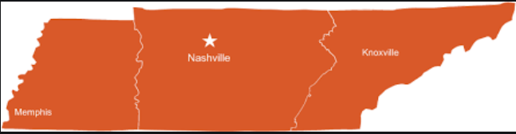
Where in TN?

Slide 5
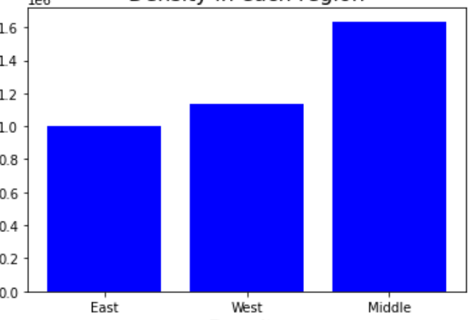
Which region?
Population by region

Slide 6
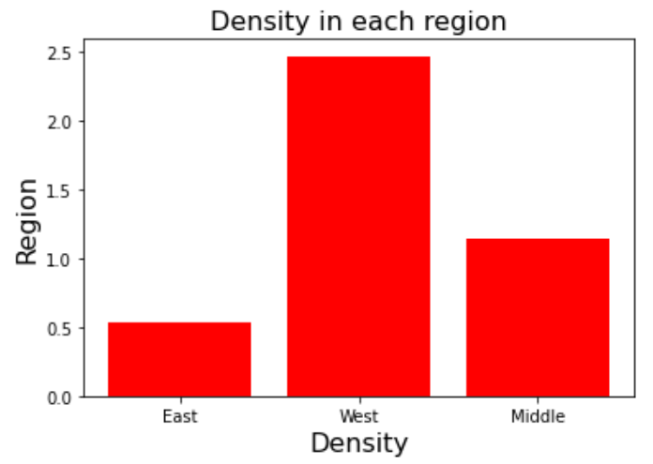
Which region?
Population density by region

Slide 7
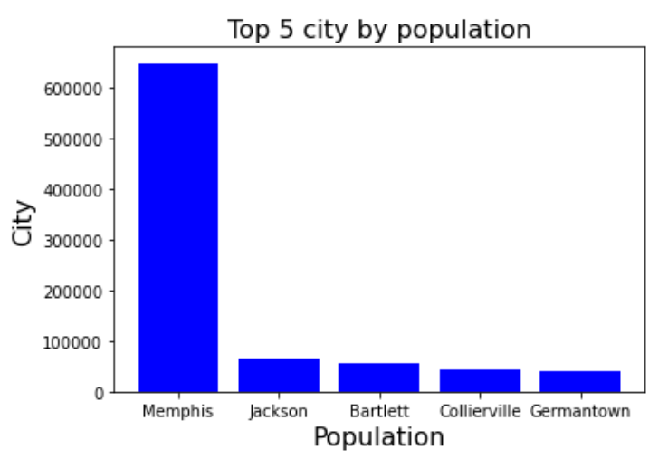
West TN! Then what city?
Population by city

Slide 8
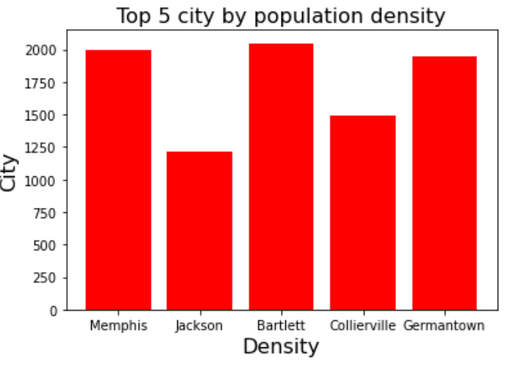
West TN! Then what city?
Population density by city

Slide 9
The city of Memphis!

Slide 10
Thank you!

